Slide 1

University of Ulsan IT Service
Notes:
I heard about this seminar two days ago.
So I can’t prepare much.
Even though this presentation has poor contents, I hope you will excuse me.

Slide 2

Embedded System Overview
Computing systems are everywhere
Most of us think of “desktop” computers
- PC’s
- Laptops
- Servers
But there is another type of computing system
- Far more common…

Slide 3
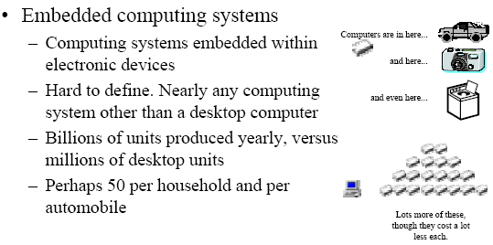
Embedded System Overview
What is an embedded system?
A physical system that employs computer control for a specific purpose,
rather than for general-purpose computation.

Slide 4
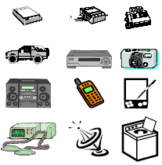
A “Short List” of Embedded Systems
Anti-lock brakes Fingerprint identifiers
Auto-focus cameras Home security systems
Automatic teller machine Medical testing systems
Automatic toll systems Modems
Automatic transmission MPEG decoders
Avionic systems Network cards
Battery chargers Network switches/routers
Camcorders Pagers
Cell phones Photocopiers
Cell-phone base stations Printers
Cordless phones Scanners
Cruise control Stereo systems
Digital cameras TV
Disk drives VCR
Electronic card readers Video game controllers
Electronic toys/games Video phones
Fax machines Washers and dryers

Slide 5
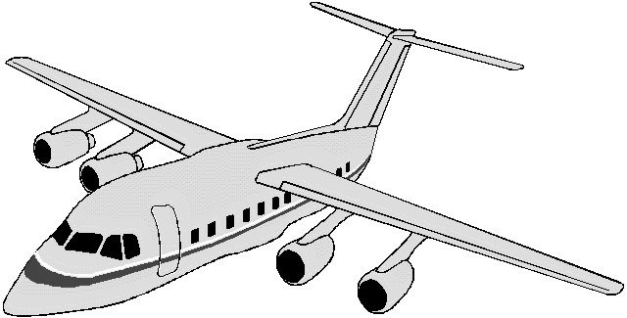


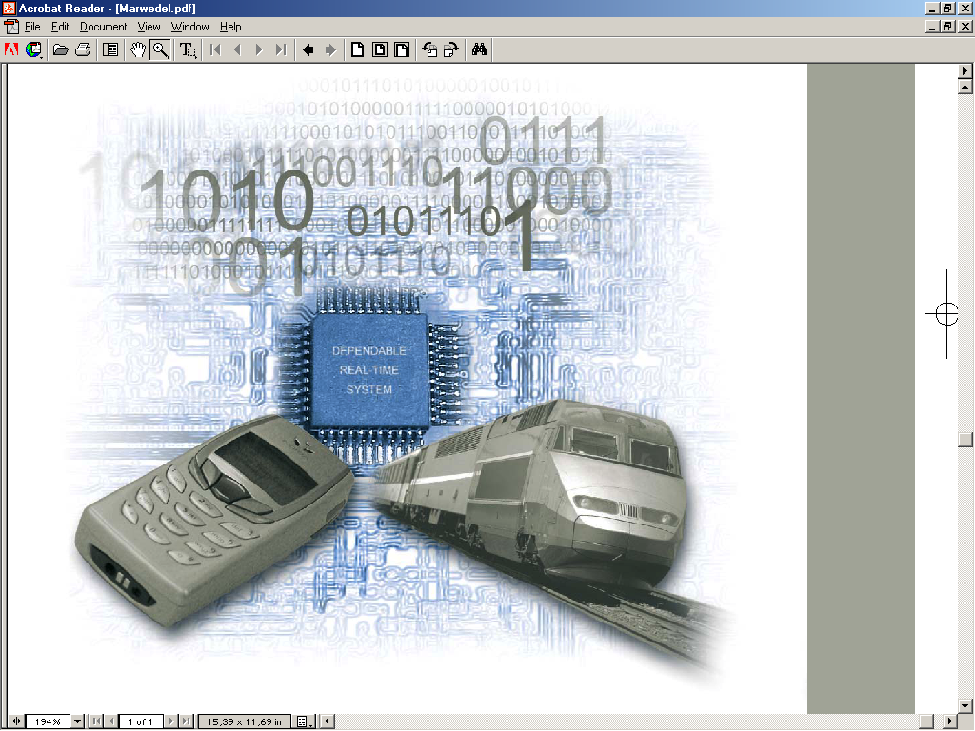
Embedded Systems
Embedded systems
  information processing systems embedded into a larger product
Two types of computing
  Desktop – produced millions/year
  Embedded – billions/year
Non-Embedded Systems
  PCs, servers, and notebooks
The future of computing!
  Automobiles, entertainment, communication, aviation, handheld devices, military and medical equipments.

Slide 6
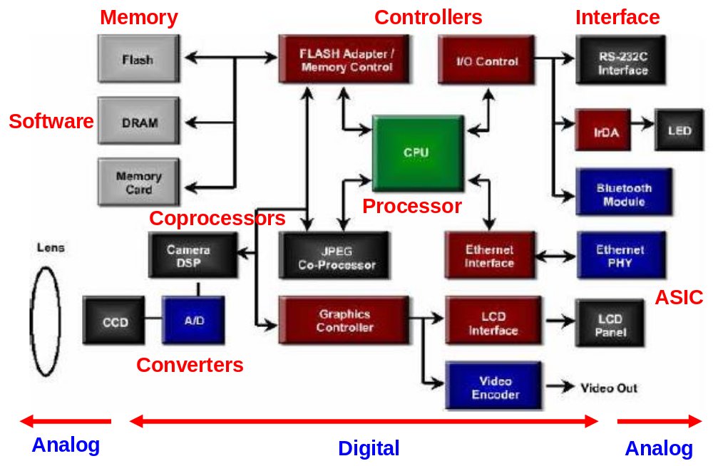
Components of Embedded Systems

Slide 7
Components of Embedded Systems
Analog components
- Sensors, controllers,…
Digital components
- Processor, coprocessors
- Memories
- Controllers, busses
- ASIC: Application-Specific Integrated Circuit, a chip designed for a particular application
Converters – A/D, D/A, …
Software
- Application programs
- Exception handlers

Slide 8
Characteristics
Application specific
- Optimize for cost, area, power, and performance
Digital signal processing
- Signals are represented digitally
Reactive
- Reacts to changes in the system’s environment
Real-time
- Compute certain tasks before deadline
Distributed, networked,…

Slide 9
Characteristics
Reliability
- Probability of system working correctly at fixed time
Maintainability
- Probability of system working correctly fixed time units after error occurred
Safety
- Not harmful for user
Security
- Confidential and authentic communication

Slide 10
Traditional Design Challenges
Low cost
Light weight
Reliability
Low power
Portable
Complexity
Ease of use
Mixed digital/analog requirements
Shrinking time-to-market
Short product lifetime
Real-time processing
Inherent concurrency
HW/SW co-design

Slide 11
Recent Design Challenges
Design complexity
Ultra low power
- Highly adaptive
- Active power management (voltage scaling, etc.)
- Alternative energy source (solar, etc.)
Internet aware
- Incorporate RF (radio frequency) technologies
- Networking capabilities
* Larger OS, middleware, etc.
* Understanding of many/changing protocols
Verification
Security

Slide 12

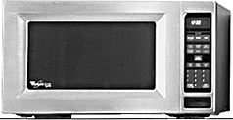



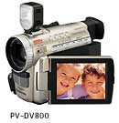
Embedded System Example – Home Network
HDTV/InternetTV
WebSearch
Microwave
Search recipe and information using internet
Home Network
Washing machine
control using internet
boiler
Control using internet
AutoControl
Refrigerater
Control using internet
camcoder
Transmit to Web

Slide 13
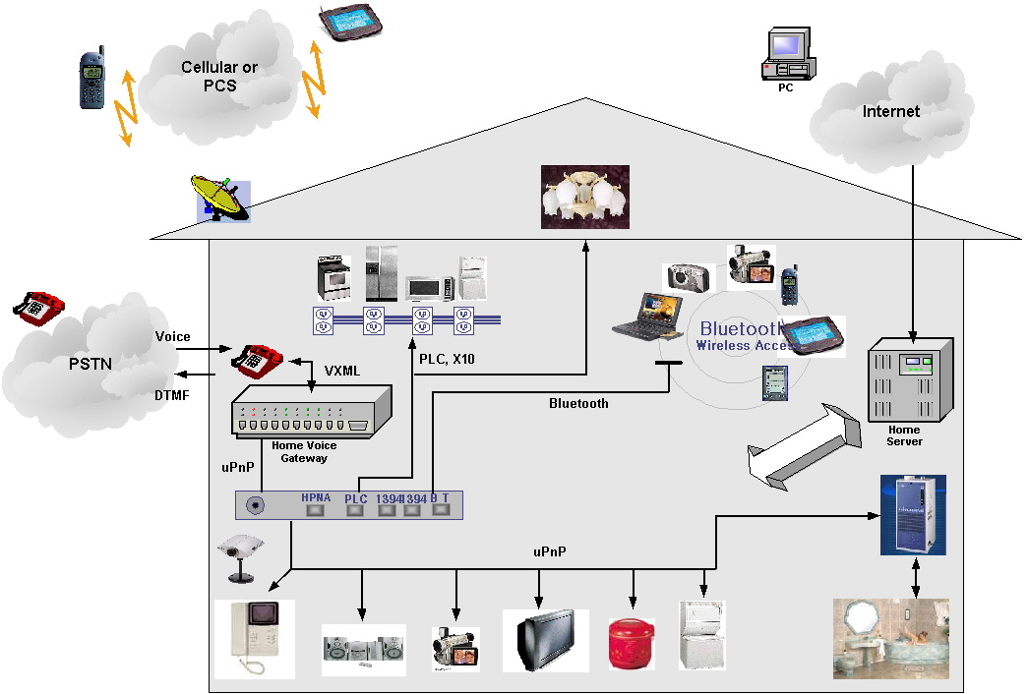
Embedded System Example – Home Automation
Goal is that RemoteController Controls all device
Nowadays the thing using Image or Sound control some device

Slide 14
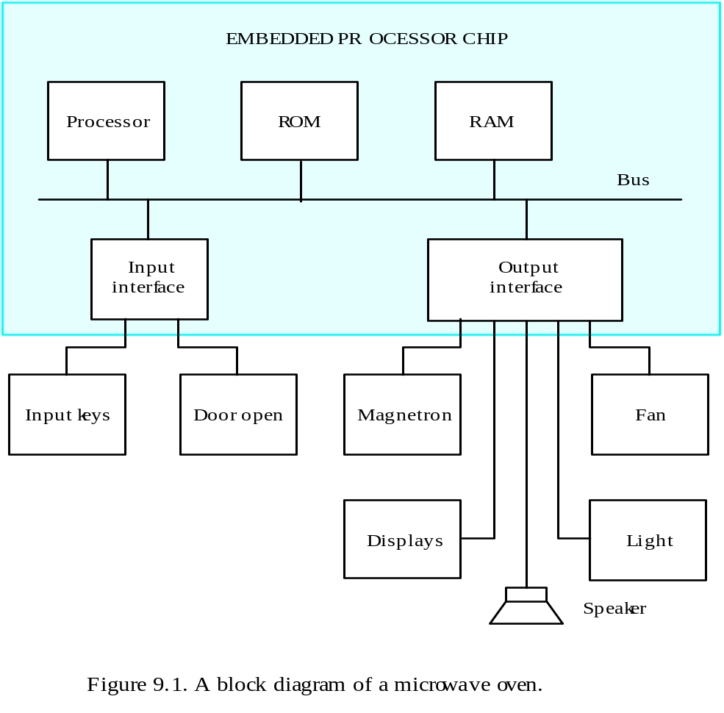
Embedded System Example – Microwave Oven
A block diagram of a microwave oven

Slide 15
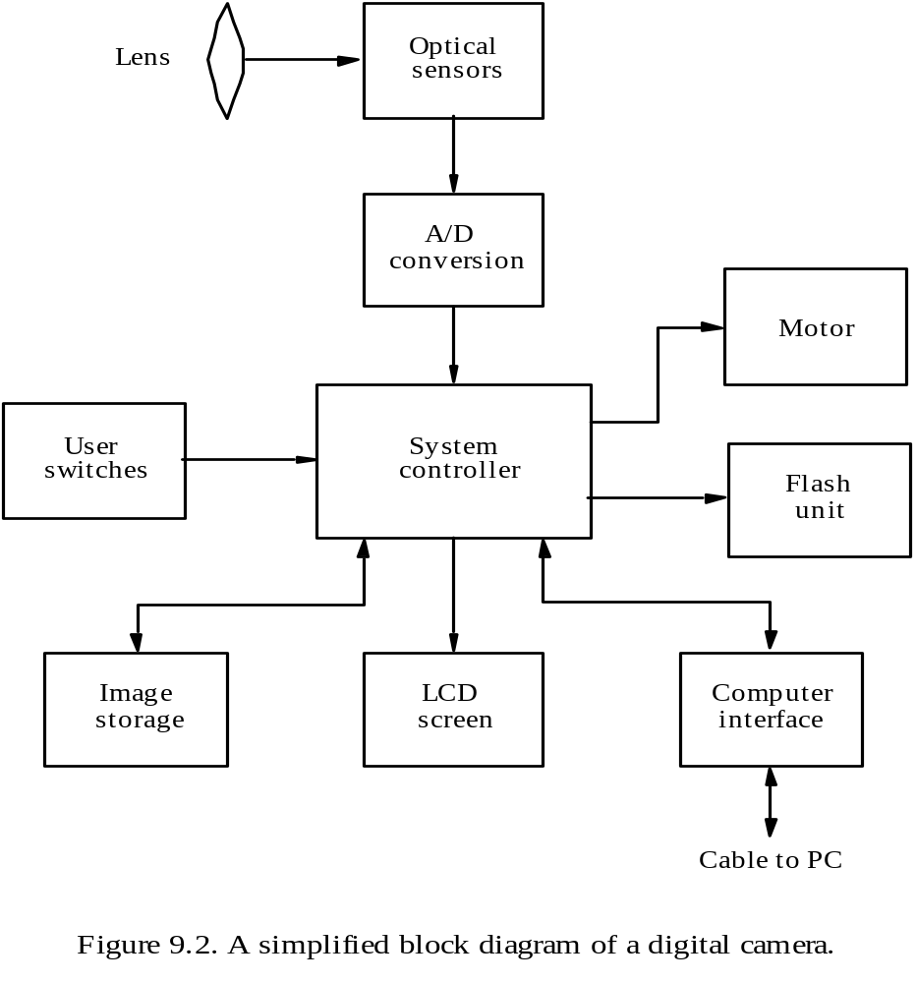
Embedded System Example – Digital Camera
A simplified block diagram of a digital camera.

Slide 16
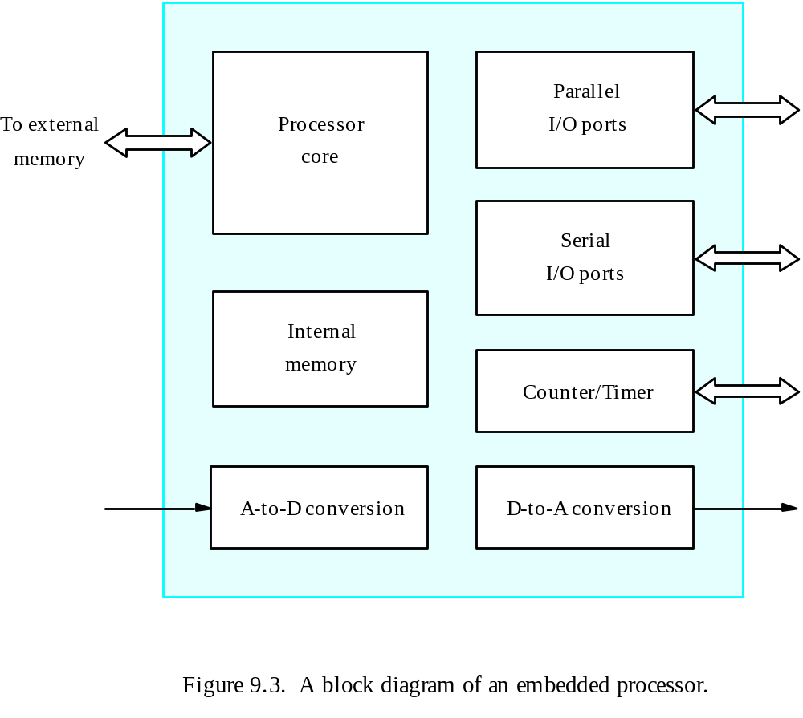
Block Diagram of an Embedded Processor
A block diagram of an embedded processor

Slide 17
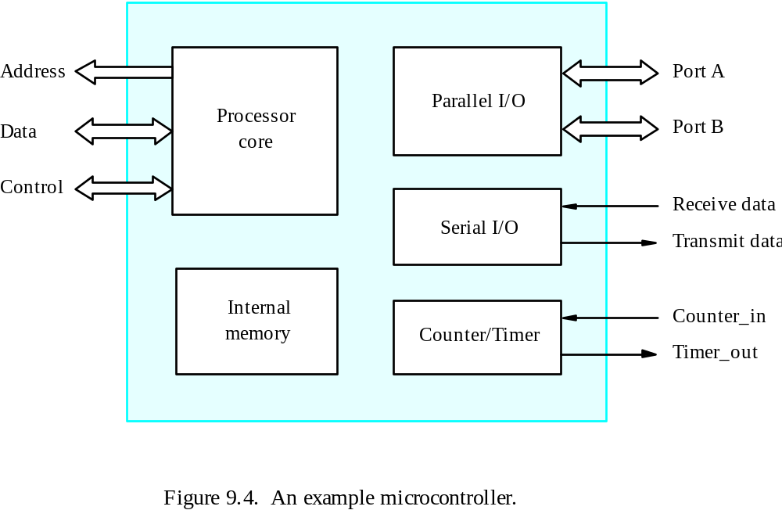
A Simple Microcontroller
An example microcontroller

Slide 18
Design Issues
Cost
I/O capability
Size
Power consumption
On-Chip memory
Performance
Software
Instruction set
Development tools
Testability and reliability

